Slide 1
Dr Francesca La Morgia
francesca@mothertongues.ie

Slide 2
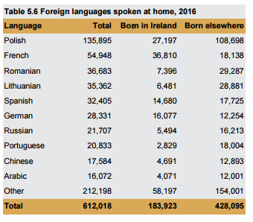
612,018 + 1.76 million + many many more
Of the 1.76 million who said they could speak Irish, 73,803 said they speak it daily outside the education system. A further 111,473 said they spoke it weekly, while 586,535 said they spoke it less often.

Slide 3
Mother Tongues’ impact
We know that…
Every year we…
PARENTS have concerns about bilingual language development
TEACHERS and EARLY CHILDHOOD EDUCATORS are looking for more information and training in the area of bilingualism and EAL
CHILDREN don’t have sufficient opportunities to use heritage languages outside the home
SOCIETY does not value languages and linguistic diversity – the view is that English is more important/not all languages are seen as equally valuable
GIVE TALKS on bilingual language development, reaching 1000 parents
TRAIN TEACHERS and EARLY CHILDHOOD EDUCATORS, impacting the lives of over 10,000 children
PROVIDE OPPORTUNITIES for 1000 children to use their mother tongue outside the home
Organise a large festival that celebrates multilingualism in Ireland, give interview on radio, newspapers and television, and bring the message to over hundreds of thousands of people.

Slide 4
PARENTS
Feel confident about raising bilingual children
Transmit their language to their children
CHILDREN
Feel that their language is valued and relevant
Embrace their heritage language
EDUCATORS
Understand that bilingualism is an asset
Encourage bilingualism

Slide 5
ACTIVITIES

Slide 6
Family storytelling in heritage languages
Different language every month
We make a list of books available in public libraries in the language
We borrow books
Parents read or tell stories
An expert is at hand to ask questions about bilingualism
Where? Dolphin’s Barn Library and Chester Beatty Library, Dublin
FUNDED BY DUBLIN CITY COUNCIL

Slide 7
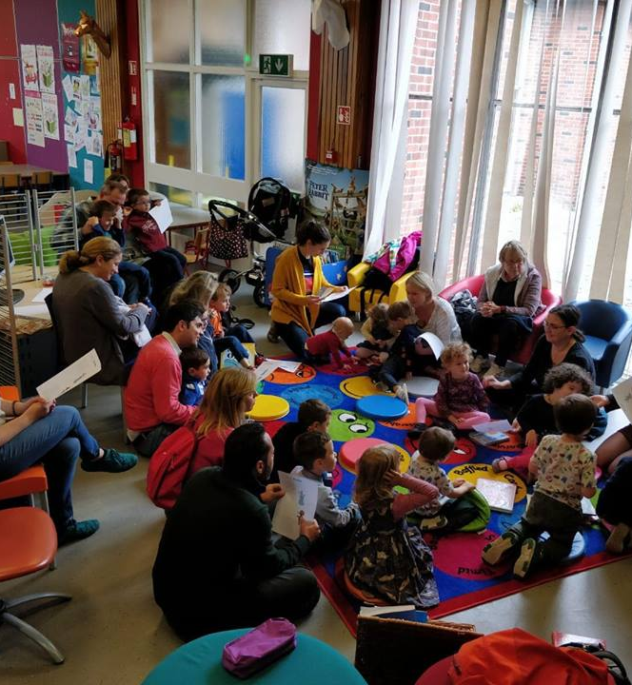
Outcomes
Parents learn from one another and share experiences
They value the experience of reading in their mother tongue
They are more likely to borrow books in their mother tongue in the future
Children see that their language is spoken by people outside their family
Languages become part of life outside the home
Parents see that public libraries value their heritage

Slide 8
Talks on raising bilingual children
Overview of what to expect at different stages of language development
Tips and techniques to raise bilingual children
Opportunity to share experiences, work in small groups, ask questions
Where? Public libraries around the country, preschools, parent and toddler groups, schools, businesses, organisations that train people who work with children

Slide 9
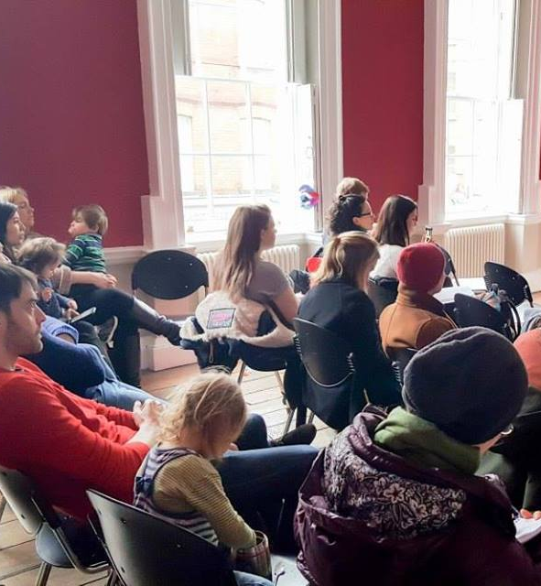
Outcomes
Parents learn from one another and share experiences
Parents reflect on the experience of raising bilingual children
Parents have become more confident in their strategies
Many positive comments on how taking part in the course has encouraged parents to use their language more
Parents organise “Talk to me in…”

Slide 10
Talk to me in…
Meet other families
Free and open to all
Language is used to socialise outside the home and with new people
Bilingualism becomes normal
Easy to organize anywhere in the country, led by parents
Where? Any public space – child friendly
Dutch, Croatian, Turkish, French, Basque, Italian

Slide 11
Language Explorers
Discovery of language and diversity
Games to play with languages
Home languages are used in class
Where? Early years settings, Primary and Secondary Schools
More than 500 pupils have taken part so far
More than 100 teachers attended training sessions

Slide 12
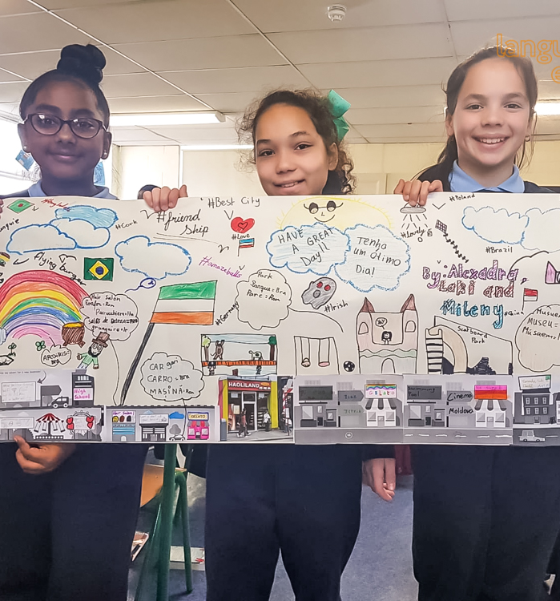
Outcomes
Children realise that all languages are equally important (English is not the only language that matters!)
Children learn about each other
Teachers learn something new about their pupils
Interest in learning about languages increases
Parents feel that their languages (and their heritage) are valued in the school
https://www.youtube.com/watch?v=jN6ZnXvMWms

Slide 13
Links with Languages Connect Implementation Plan
The Strategy sets out four overarching goals:
Improve language proficiency by creating a more engaging learning environment.
Diversify and increase the uptake of languages learned and cultivate the languages of the new Irish.
Increase awareness of the importance of language learning to encourage the wider use of foreign languages.
“The presence of other heritage languages in our primary schools will be explicitly acknowledged in the implementation of the new Primary Language Curriculum for early childhood and primary education.”

Slide 14
Harnessing potential
2. Parents promote children’s maintenance of the heritage language
3. Increase in uptake of heritage language courses in secondary
More good quality heritage language speakers
More fluent speakers of foreign languages = more language teachers and more employable in the global workforce
1. Empower parents

